Slide 1
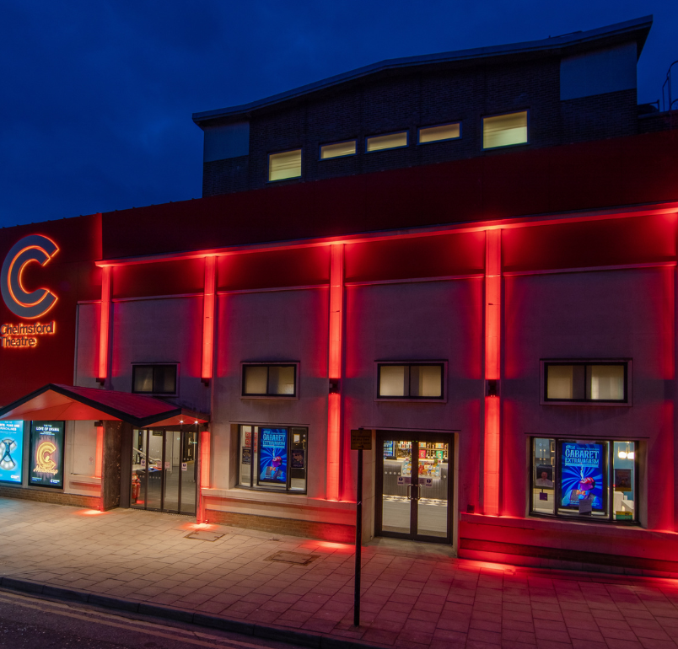
2023 Portfolio Update Connected Chelmsford
Cllr Marie Goldman
Deputy Leader, Cabinet Member for Connected Chelmsford

Slide 2
Revenues & Benefits
Successfully incorporated the 2 new parishes and their Council Tax liabilities for 2023/24 annual billing process.
Devised the internal processes and delivered three more ad-hoc Government grants:
  Up to £25 reduction to Council Tax bills for Council Tax Support recipients;
  Two Energy Support grants totalling £479,600 to 1,571 applicants.
  These are in addition to the day job of processing benefits and collecting Council Tax/Business Rates.
Rob Hawes

Slide 3
Procurement
Successful continuation of delivery of procurement service for Uttlesford District Council
New staffing in Risk & Insurance
Successful defence of high value insurance claim
Alison Chessell

Slide 4
Human Resources
Launch of new, more user friendly and accessible recruitment site.
Working closely with Job Centre Chelmsford to supply vacancy information for a dedicated job board along with Job Coaches.
HR Support team regularly attending job fairs to meet with job seekers and coaches.
CCC jobs advertising now installed in Fairfield Road car park
80% of roles being successfully recruited to from first round of advertising (Data from January to June 2023)
2023 Pay Award implemented for staff
(MFA) Multi Factor authentication has been implemented for iTrent users.
Director recruitment for Sustainable Communities successfully completed
Member Induction completed and Member Training and Development group set up to discuss training and development needs for members.
Debbie Wootton

Slide 5
Legal & Democratic
2023 Local Elections
  Successful delivery the Local (City and Parish) Elections 2023
  Major whole council team achievement.
Register of Interests
  Process simplified and moved to online form
Legal case management system (Iken)
  Fully operational
  All current legal cases now live
  Developing workflows to help further streamline processes
Information requests
  874 requests received. (785 in 202/22)
  90% processed within statutory timescales
  None referred to ICO.
Lorraine Browne

Slide 6
Michael Sage
Apprenticeships
  6 apprentices have completed and passed their courses this year (3 joined CCC permanently)
  Continue to invest in apprenticeships
Windows 11 / New Devices
  Procured and started rollout.
  Migrating more services to Microsoft platform, including anti-virus and Teams (introducing savings from discontinuing 3rd party services).
Website Migration
  Main website moved
  Microsites started
  Inhouse development leading to savings
Dynamics
  Several releases
  Full development roadmap until Oct 2024
Digital Services

Slide 7
Marketing
A few examples of success…
Hylands Estate
  200% increase in page views to the new Hylands Estate Weddings website, which launched in September 2022.
  46% increase in unique visitors
  18% increase in repeat visitors
Chelmsford Museum
  75 % engagement increase in Facebook page in first 6 months of 2023
  58% additional reach increase
Tindal Square
  Summerballoo launch event marketing
60,000 unique email addresses
  9,000 increase over past 12 months
Ali Naqvi

Slide 8
Communications
City Life website
  2,500 people (including journalists) who receive push notifications when a new story appears
  Increase of circa 500 in the last 12 months.
Nextdoor
  Started using Nextdoor.co.uk, although with mixed results.
Love Your Chelmsford
  Working more closely with LYC team
  New combined e-shots to public agreed and scheduled
E-Shots
  City Life Friday e-shot has 12,895 current subscribers and the
  Open rate is around 48%. (GovDelivery benchmark for top 20% performers in local Government group is 40% open (median 38%).
Ali Naqvi

Slide 9
Ali Naqvi
Closed on Wednesdays since 19th June
  Still takes emergency calls
  Appreciated by staff
  Time to keep up-to-date with online enquiries
Top 3 calls:
  Council Tax, Housing, Benefits
Type of contact | 2022 (Sep-Aug) | 2023 (Sep-Aug)
Calls | 94,049 | 85,732
Online | 14,993 | 18,330
Housing Register | 563 | 1,107
Frontline visitors | 6,351 | 8,135
Customer Service Centre

Slide 10
Cultural Services
Chelmsford Museum
  2500 people attended Carnival Finale in July
  Behind the Rainbow exhibition kick-started an ongoing relationship with Essex Pride.
  School education sessions continue to be sold out with fantastic feedback from teachers.
  Now expanding the museum’s offer for children with SEND.
Cultural Partnerships
  Ignite - 13 new people recruited to represent the voice of the district's thriving Creative Sector.
  Over 250 Ignite members and continuing to grow every day
  Youth Forum led its first-ever event in September representing the voice and shaping the futures of young people in Chelmsford
Marc De’ath

Slide 11
Cultural Services
Festivals and Events
  Science Festival at ARU
  Concrete Canvas
  New events space at Tindal Square
Chelmsford Theatre
  Completed refurbishment with excellent feedback from audiences
  40% of the Theatre’s audiences are new
  Sold-out shows have doubled since re-opening, including 2 weeks of West End Touring Shows, Blood Brothers & Mousetrap
Marc De’ath

Slide 12

Questions?

